Slide 1
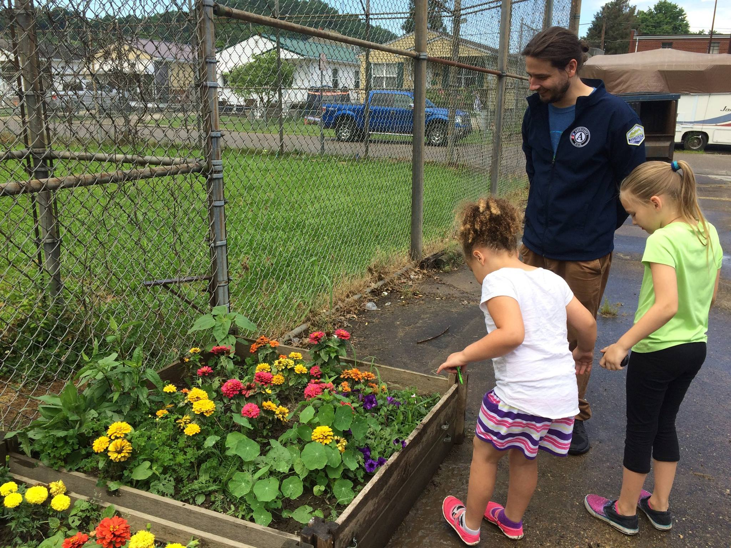
Energy Communities AmeriCorps
Huntington, WV: Stewards VISTA Nathan Luton
Notes:
Hannah
Intro Slide: Welcome everyone and thank you for your interest in our energy communities AmeriCorps program. (intro); we will take a minute and introduce ourselves to you so you know who we are and while we do that please introduce yourself in the chat, tell us where you're from and the organization you represent. (make sure to check attendees to see if Sandy, or Briggs are on the call)
Kick to Shelby for story
Huntington, WV: Stewards VISTA Nathan Luton served with the Ohio Valley Environmental Coalition. A major aspect of Nathan's service was building out partnerships with Boys & Girls clubs to teach youth and children about raised bed gardening, cooking and healthy eating, and entrepreneurialism. Nathan created and facilitated educational nature and gardening workshops with the clubs, teaching about seed bombs, wildflower seeds, composting, and home gardening. The clubs then planted raised bed gardens and had successful harvests. Nathan then partnered with the local WV extension office to arrange bi-weekly cooking classes which used the harvests to teach the youth about cooking and healthy diets. A farmer's market vendor also purchased some of the crops with the proceeds going back to the Boys & Girls Club. Nathan also planned public outreach activities surrounding Earth Day and worked with a partner on a solar panel installation project.

Slide 2
Today’s Agenda
Introductions
Conservation Legacy & Stewards Individual Placements
Energy Communities AmeriCorps Program
Host Site Information
VISTA program benefits
Program Overview
Benefits to the site
Application process and timeline
Q&A
The Energy Communities Interagency Working Group
Where are Energy Communities?
Host site responsibilities
Conservation Legacy's role
Application process, deadlines, and materials
Cohort timeline
What is a VISTA?
Notes:
Shelby leads introduction and shares agenda.
Intros for STE staff, Sandy, Briggs, any others

Slide 3
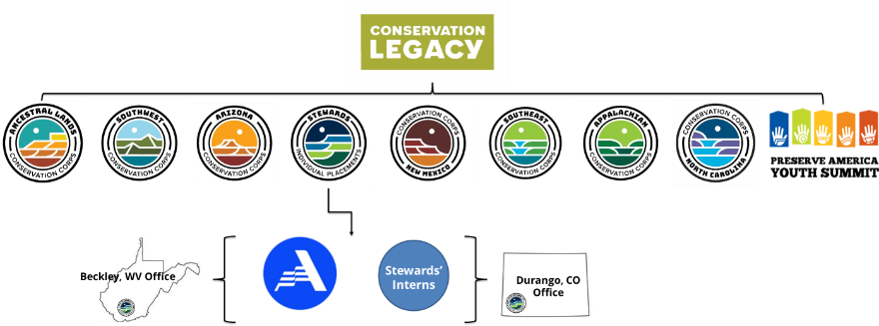
Conservation Legacy
Conservation Legacy is a national organization engaging youth, young adults, and veterans in conservation and service programs from 15 locations nationwide. Stewards Individual Placements is a program of Conservation Legacy
Our programming is embedded in local communities to make the greatest impact by meeting on-the-ground needs.
At our core is a dedication to national and community service—we are a part of something BIGGER.
Notes:
Hannah– highlight the slide improvise while we are a national program, we pride ourselves in our programming as it is embeded in local communities …. end with we know we are part of something bigger...

Slide 4
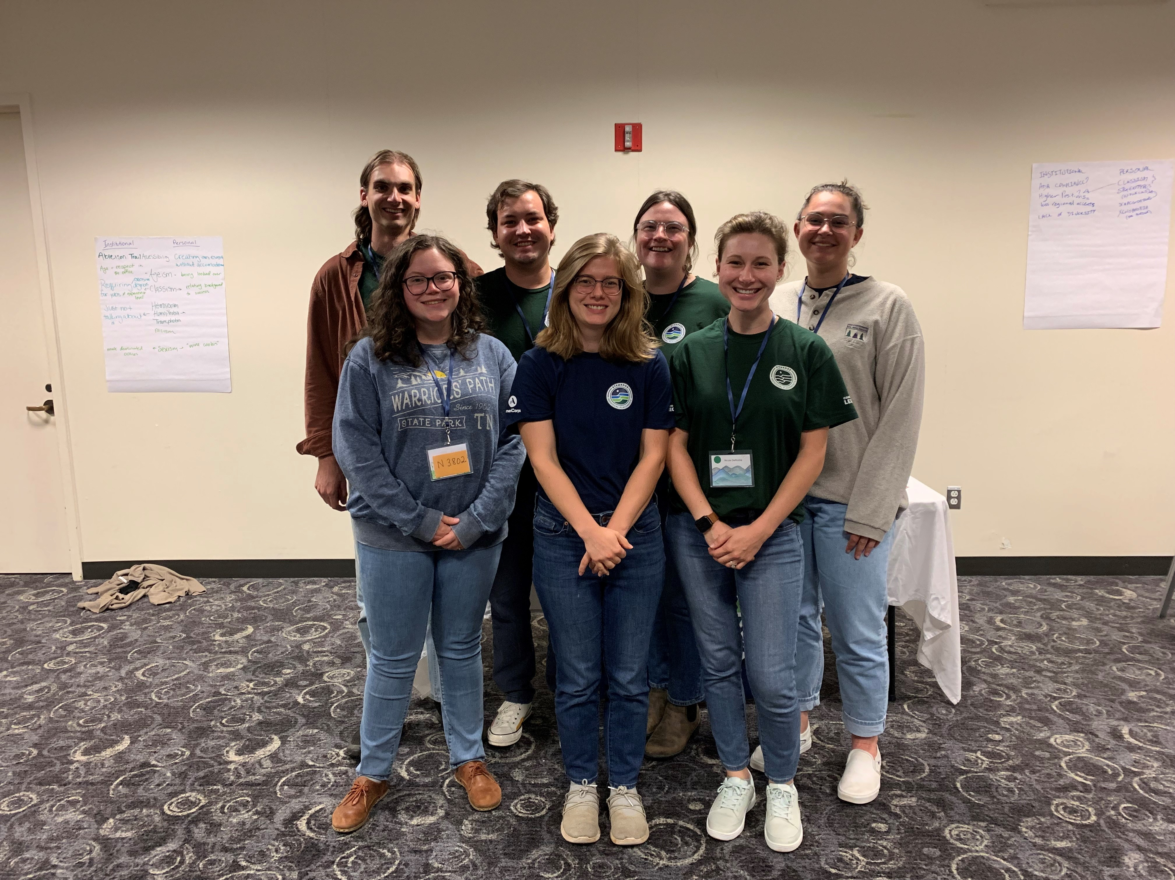
Stewards Individual Placements
Our Mission
Stewards Individual Placements provides individuals with service and career opportunities to strengthen communities and preserve our natural resources. Participants work with federal agencies, tribal governments, and nonprofits building institutional capacity, developing community relationships, and supporting ecosystem health.
Over 600 members with...
VISTA Training with Stewards in West Virginia
AmeriCorps VISTA
OSMRE
NPS Historic Preservation Training Center
Boston Climate Conservation Corps
US Fish & Wildlife LIDAR
Youth Empowerment Stewards
West Virginia READY
And many more!
Notes:
Hannah- highlight the misison; take a minute to share the porfolio
AC VISTA- is our longest standing program where we have placed VISTAs across the country of the last 23 years! And now we launching Energy Communities under our VISTA umbrella
OSMRE is where our programming started
HPTC is our apprenticeship program that is providing training in the trades (carpentry, woodworking, and masonry);
We launched a program with Boston parks called the boston climate corps focused climate impacts at the park and city of Boston.
LiDAR is our newest program, members are completing surveying using light detection technology for refuges'
Youth Empowerment Stewards is our programming that supports opportunities for individuals with a different ability to have a service experience
In 2022 we launced a specialized program in WV, WV READY where we are placing national service members across the state to support community plans to develop outdoor recreational programming
Kick to Shelby for story
Here we have pictured several VISTAs from around the country who attended our recent in-person VISTA training with our team in Beckley, WV. Stewards offers in person training opportunities for our VISTA cohorts which focus on professional development trainings but also on connecting the members to each other so that they can share their experiences in their host communities and offer each other what they have learned in their terms, building their professional network. They also explored the Beckley area and New River Gorge!

Slide 5
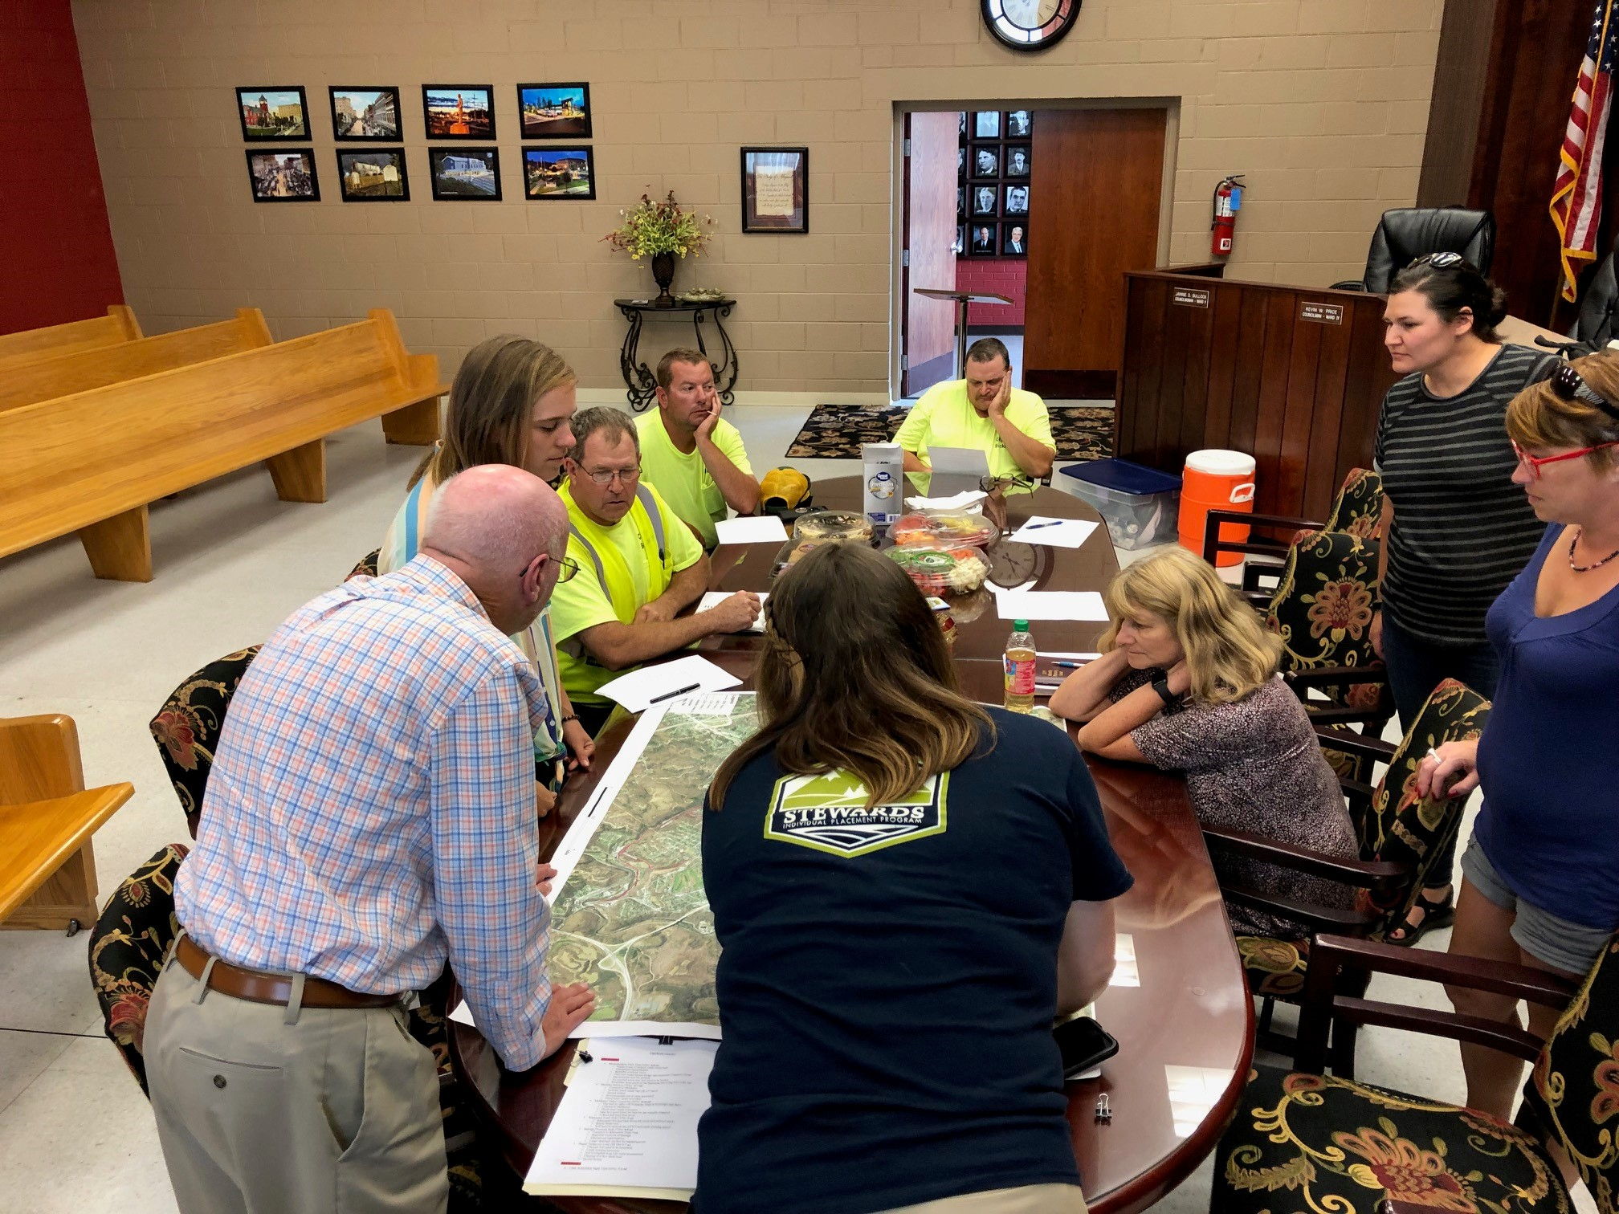
What is a VISTA?
Volunteers in Service to America
1 year of service
Service is "indirect"
Sustainability post-term
Poverty alleviation
Energy Communities VISTAs:
Building the capacity of energy communities to develop and implement locally driven environmental remediation and economic development
Beckley, WV: Kaitlin McBride, Stewards VISTA
Notes:
John
Beckley, WV: Kaitlin McBride, Stewards VISTA serving with Beckley Sanitation Board, presents in a Bicycle Pedestrian Action Committee meeting where the city’s mayor approved their trail expansion project proposal. Kaitlin assessed pedestrian access needs, created maps of current sidewalks to assess walkability, mapped potential trail routes along existing sewer lines, visited and scouted the potential sites, and then created the project implementation plan and timeline. Kaitlin also supported watershed monitoring efforts and learned GIS as a part of her training for her projects. She returned to school following her term.

Slide 6
VISTA Program Benefits
For VISTA member:
Living Allowance: $15.51/hr equivalent
Professional Development Training
Non-Competitive Eligibility for Federal Jobs
End of Service Award - $7,395 Segal Education Award or $1,800 cash stipend
Loan Deferment and Interest Repayment
Healthcare and Childcare Benefits
Relocation Expenses
Cohort Community Model
Paonia, CO: Stewards VISTA Lauran Swartz with Western Slope Conservation Center
Notes:
John
Paonia, CO: Stewards VISTA Lauran Swartz serves as the Outreach Coordinator VISTA at Western Slope Conservation Center. Lauren planned a ribbon cutting ceremony for the local Paonia River Park, pictured here. Due to flooding, much trail reconstruction was performed, and the event engaged the community to celebrate the reopening of the trail and the hard work of those who rebuilt it. Along with building an invite list and creating invitations, Lauren designed this wreath garland to serve as an environmentally friendly “ribbon”, created posters for the event, sent a press release to local media, and planned an environmental education-focused scavenger hunt for participating students. 105 students and their teachers from the local PK-8 school, members from the Rotary and Lions clubs, representatives from The Nature Connection, and WSCC volunteers were in attendance.

Slide 7
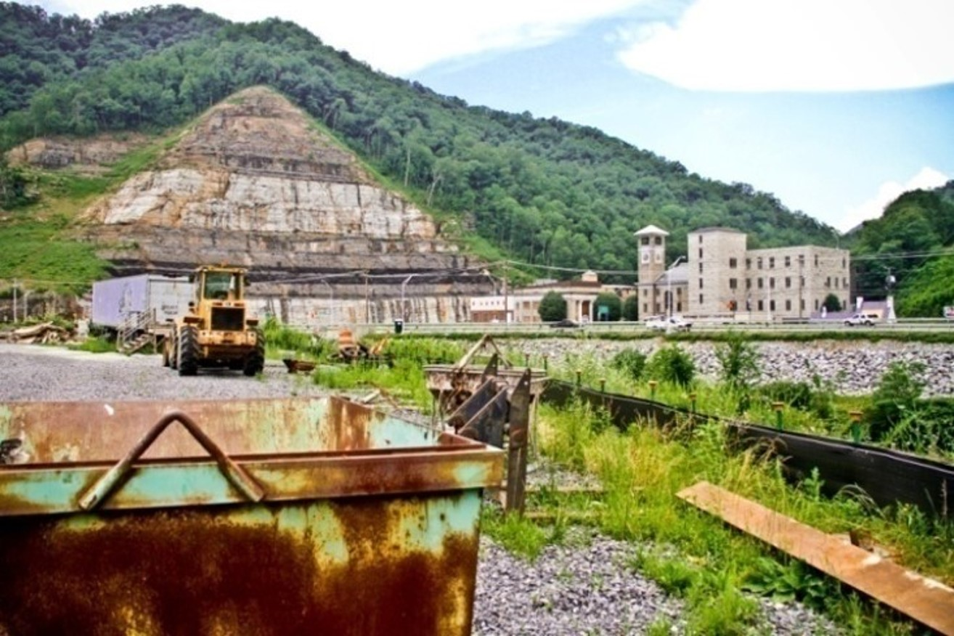
Energy Communities AmeriCorps
135 VISTAs Over 3 years
Build capacity of nonprofit & public agencies in Energy Communities to develop and implement locally driven economic development, environmental remediation, and energy transition plans, diversifying their local economies.
Members will serve "behind the scenes" to support your organization through asset mapping, volunteer mobilization, outreach on tax credit and grant opportunities, community engagement, data analysis, and program development.
Grundy, Virginia
Notes:
Hannah-
Our ECAP project is a partnership with various federal agencies that will support 135 VISTAs annually over the next three years; (highlight activities)

Slide 8
Where are Energy Communities?
Nine regions:
Appalachian Ohio
Eastern Kentucky
Four Corners
Illinois Coal Basin
Montana
Southwest Virginia
West Virginia
Western Pennsylvania
Wyoming
Map courtesy of energycommunities.gov
Notes:
Hannah
Our ECAP placements will focus on the nine regions. These regions are those the IWG identified as priority areas as those are the ones with the most pressing needs and/or are experiencing energy transitions now. (share regions)

Slide 9
Being a Host Site
Benefits
Increased capacity to carry out mission
Sustained fulltime support for 3 years
No host site fees!
Conservation Legacy handles grant and project administration
Dedicated program support from Stewards staff with 20 years of experience managing VISTA projects
Access to several national networks: Conservation Legacy, AmeriCorps, ECIWG
The ideal host site:
Dedicated mentors provide at least 10% of their time to support their VISTAs
Office space and equipment
Ability to reimburse for member travel for service-related tasks
Assist in recruitment selection process
Assist members in locating housing
Attend orientation webinar
Notes:
Trish
Mention that VISTAs often become employees of host site. (Removed from benefits bullets per John's suggestion)
ECIWG - Energy Communities Interagency Working Group

Slide 10
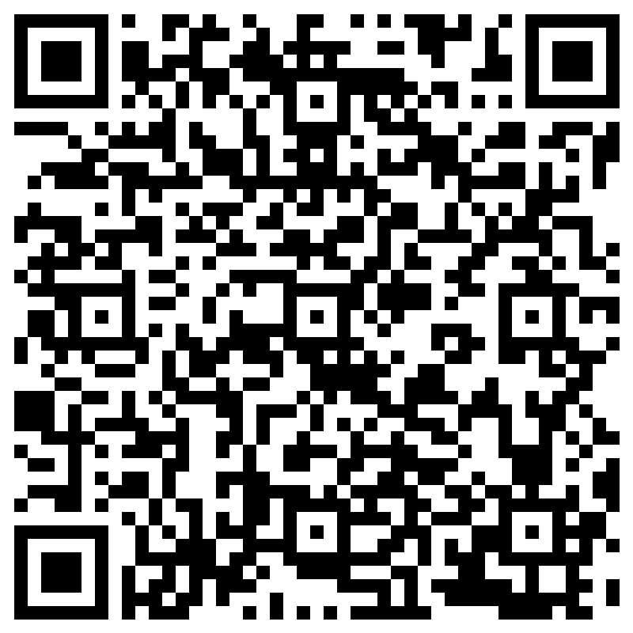
Next Steps: Call For Sites & Site Application
Seeking host sites to support Spring 2025 cohort
Submit
Application by
Monday, Nov. 25th
Member Recruitment: Dec, Jan, Feb with member selection deadline Feb. 17th
Application materials:
Organization Information
Focus Areas
Application Link:
https://forms.office.com/r/0E2NXUgxHH
Notes:
Trish - open application link and talk through.
October cohort possible dates, end of August application deadline, aiming for 30 vistas, mention upcoming CL landing page, apply now if you are not included in Fall cohort it will be moved to spring cohort

Slide 11
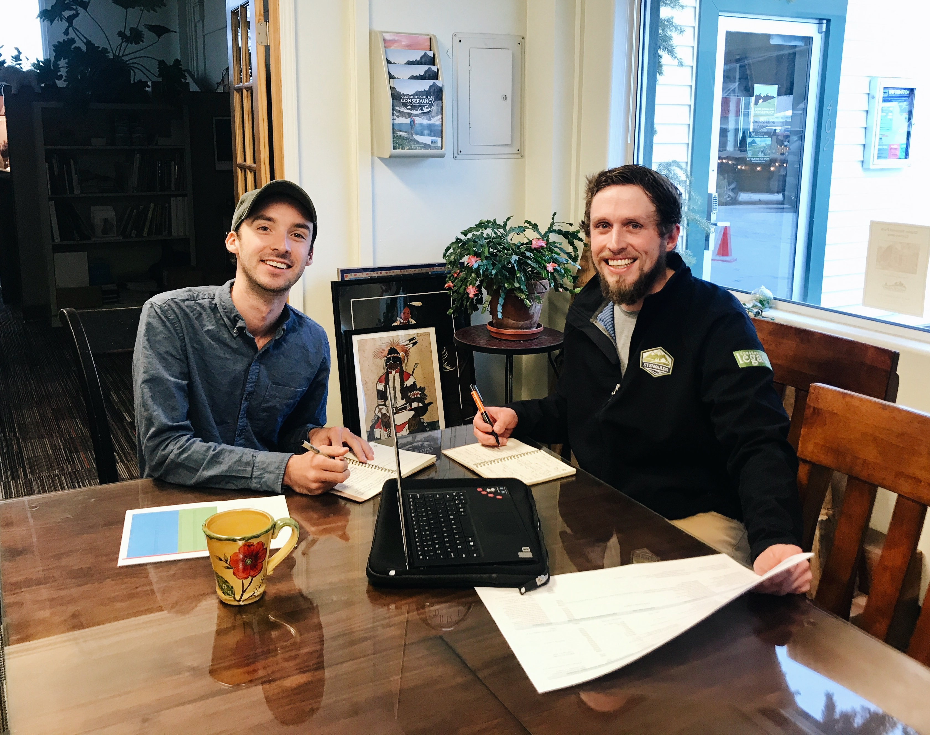
Spring Cohort Timeline
Nov. 25th 2024
Application Deadline
Feb. 17th 2025
Member Selection
April 7th 2025
Deadline
Member Start
April 6th 2026
Service term concludes
Montana: Jeff Babik, Stewards VISTA with Glacier National Park Conservancy
Notes:
Shelby
Kick to Shelby for story
Jeff Babik served as a Stewards VISTA with the Glacier National Park Conservancy. In this role, Jeff applied for dozens of grants, conducted compliance presentations and reviews per grant requirements, led private foundation outreach, trained in CRM use and assisted in developing the Conservancy's CRM database, and presented on his efforts in board meetings. Though the onset of the COVID pandemic thwarted some of these fundraising efforts, Jeff still managed to raise thousands of dollars for the Conservancy. Jeff landed a job a non-profit job following his service.
Application deadline: End of August
Member selection deadline: September 2024
Member start: October 2024
Make sure to explain character limit

Slide 12
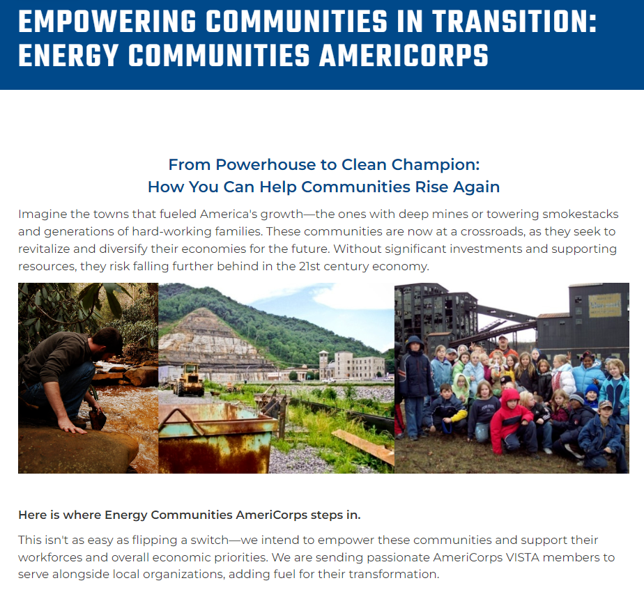
Conservation Legacy Landing Page
Resources and Additional Information
Landing page link:
https://stewardslegacy.org/ecap
Further information and useful language
Host site interest form
Recruitment hub
FAQs
Links and news
Notes:
Shelby - discuss landing page

Slide 13
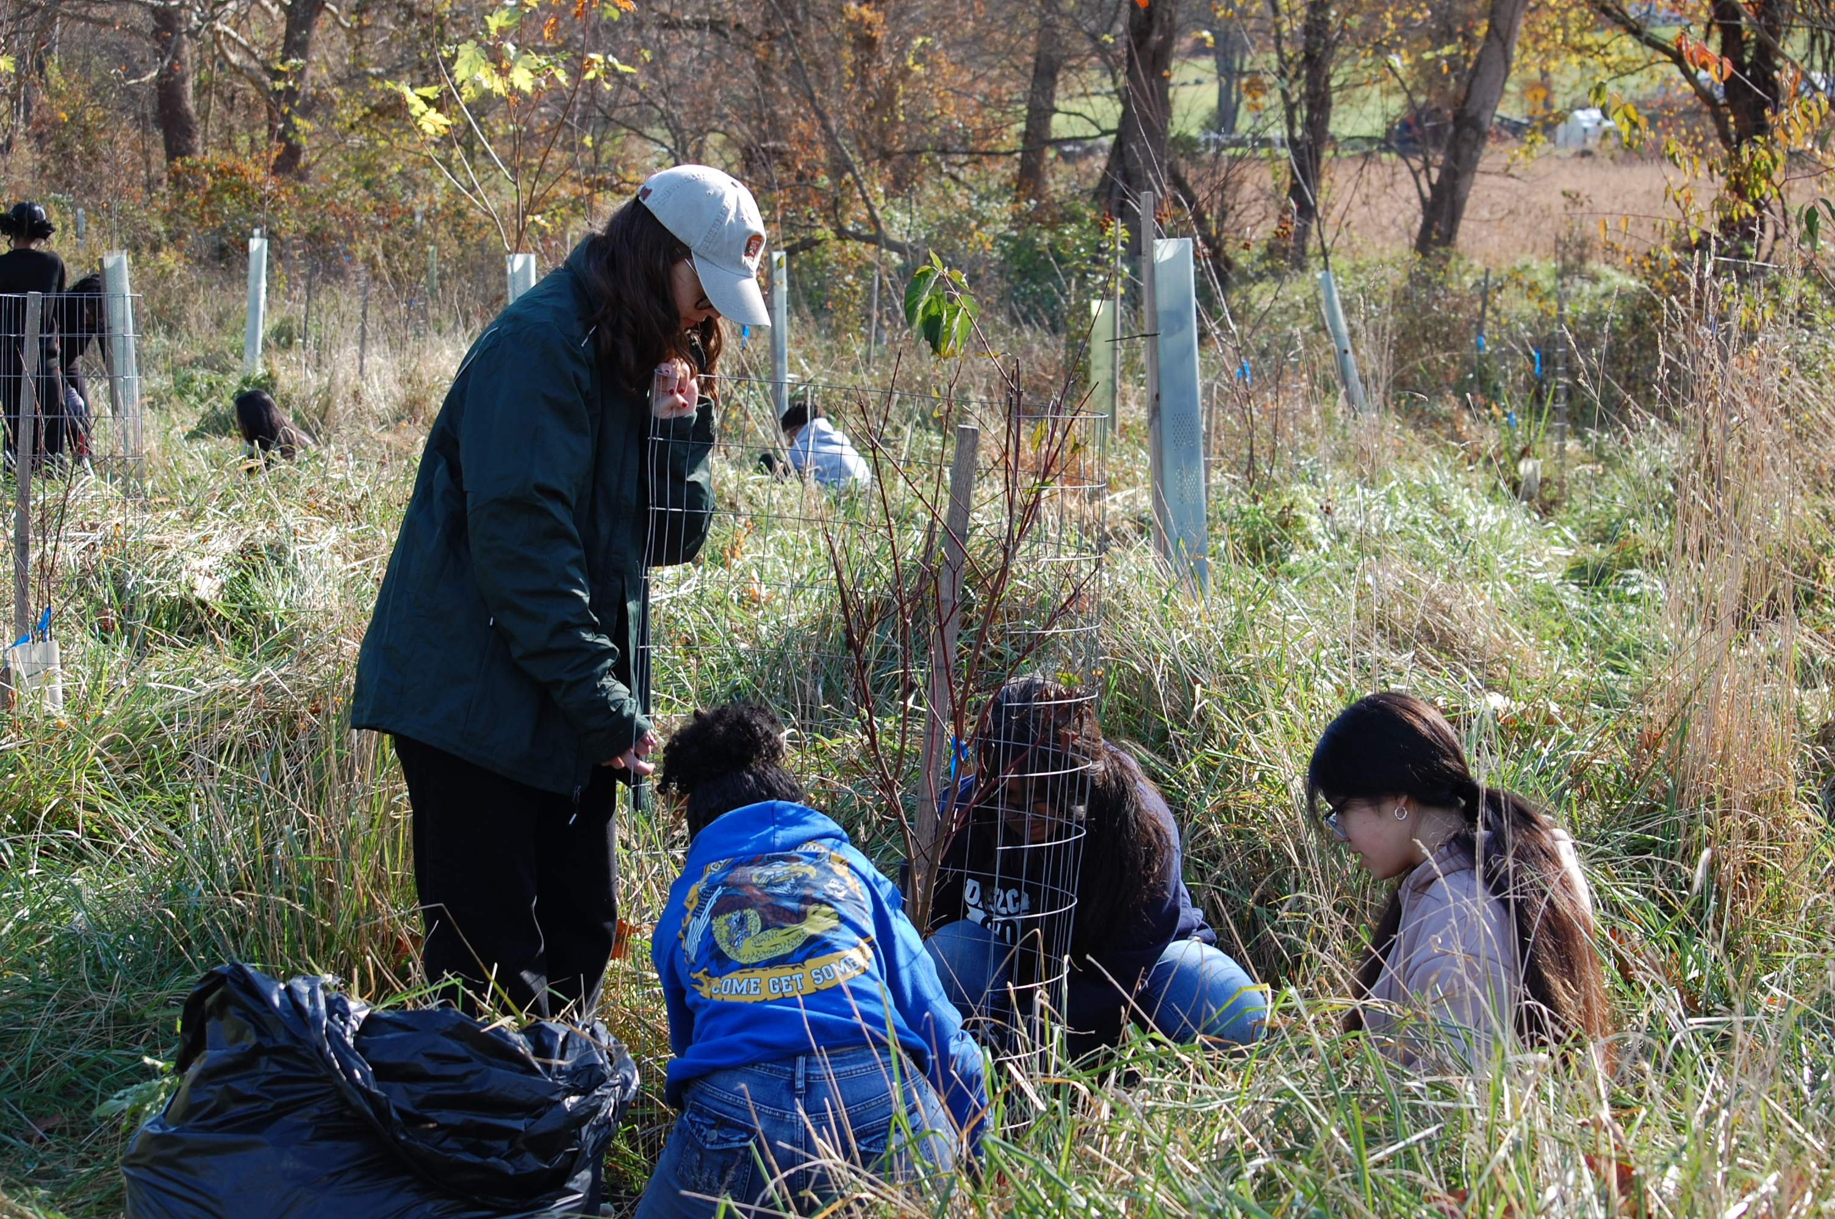
Questions?
Hannah Stone, Program Director email: hstone@conservationlegacy.org
April Elkins-Badtke, Executive Director email: april@conservationlegacy.org
Shelby Street, Program Coordinator email: sstreet@conservationlegacy.org
Thank you for your time, interest, and support of the Energy Communities AmeriCorps Program!
New Castle, DE: Lex Cervantes, Stewards VISTA at First State National Historic Park.
Notes:
Shelby
Kick to Shelby for story
New Castle, DE: Lex Cervantes serves as a Stewards VISTA at First State National Historic Park.
As volunteer and logistics coordinator, Lex organized Riparian Buffer Service-Learning programs, pictured here, manages the volunteer program and newsletter, created SOPs for the new park, and "played an integral role in shaping the next 5 years of FRST’s future". Lex also assisted with creating the park's trail management and is conducting research for a Historic Resource Study, an Archeological Overview Assessment, and a Cultural Landscape Inventory.

